Slide 1


Microprocessors and Assembly Language Spring 2020
Hamed Farbeh
farbeh@aut.ac.ir
Department of Computer Engineering
Amirkabir University of Technology
Lecture 24

Slide 2
Copyright Notice
Parts (text & figures) of this lecture are adopted from:
Arm Assembly Language Programming and Architecture, Volume 1, 1st edition, Muhammad Ali Mazidi, Sarmad Naimi, and Sepehr Naimi, MicroDigitalEd, 2013.
Microprocessors and Assembly Language, Spring 2020, AUT, Tehran, Iran

Slide 3
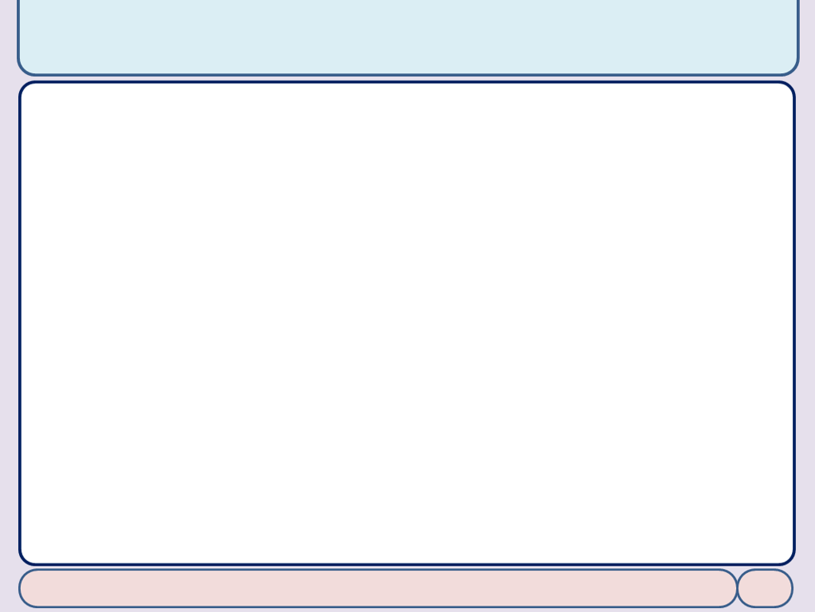
Appendix C: Macros
Microprocessors and Assembly Language, Spring 2020, AUT, Tehran, Iran

Slide 4
Macro
Write the task once and invoke it whenever it is needed
MACRO definition
MACRO [$label] macroName parameter1, parameter2, ..., parameterN ... ... ... ... MEND
MACRO ADD3VAL $DEST, $ARG1, $ARG2, $ARG3 ADD $DEST, $ARG1, $ARG2 ADD $DEST, $DEST, $ARG3 MEND
To distinguish parameters, they must start with $
AREA CODE1, READONLY, CODE MOV R1, #5 MOV R2, #2 ADD3VAL R0, R1, R2, #5
Microprocessors and Assembly Language, Spring 2020, AUT, Tehran, Iran

Slide 5
Macro
Default Values for parameters
MACRO ADD3VAL $DEST, $ARG1=R3, $ARG2, $ARG3=#5 ADD $DEST, $ARG1, $ARG2 ADD $DEST, $DEST, $ARG3 MEND
To use the default value, put a ‘|’ instead of the parameter
ADD3VAL R0, R1, R2, |
Microprocessors and Assembly Language, Spring 2020, AUT, Tehran, Iran

Slide 6
Using Labels in Macros
Labels must be unique
MACRO
$lbl OUR_MACRO
CMP R1,#5
BEQ $lbl
MOV R1, #1
$lbl
MEND
AREA OURCODE, READONLY, CODE ENTRY
MOV R1, #3
Label1 OUR_MACRO
MOV R1, #5
Label2 OUR_MACRO
HERE B HERE
Microprocessors and Assembly Language, Spring 2020, AUT, Tehran, Iran

Slide 7
Using Labels in Macros
Multiple labels inside a macro
MACRO
$lbl OUR_MACRO
CMP R1, #5
BEQ $lbl.equal
MOV R1, #1
B $lbl.next
$lbl.equal
MOV R1, #2
$lbl.next
MEND
AREA OURCODE, READONLY, CODE
MOV R1, #3
label1 OUR_MACRO
MOV R1, #5
Label2 OUR_MACRO
HERE B HERE
MOV R1, #3 CMP R1, #5 BEQ label1equal MOV R1, #1 B label1next label1equal MOV R1, #2 label1next MOV R1, #5 CMP R1, #5 BEQ label2equal MOV R1, #1 B label2next label2equal MOV R1, #2 label2next HERE B HERE
Microprocessors and Assembly Language, Spring 2020, AUT, Tehran, Iran

Slide 8
Conditional Macros
We can pass condition into macros
MACRO
$lbl OurMacro$cond
CMP R1, #5
B$cond $lbl.equal
MOV R1, #1
$lbl.equal
MEND
AREA OURCODE, READONLY, CODE
MOV R1, #3
label1 OurMacroEQ ; in the macro check equality
MOV R1, #3
label2 OurMacroLO ; in the macro check if is lower
HERE B HERE
MOV R1, #3
label1 OurMacroEQ
CMP R1, #5
BEQ label1equal
MOV R1, #1
label1equal
MOV R1, #3
label2 OurMacroLO
CMP R1, #5
BLO label2equal
MOV R1, #1 label2equal HERE B HERE
Microprocessors and Assembly Language, Spring 2020, AUT, Tehran, Iran

Slide 9
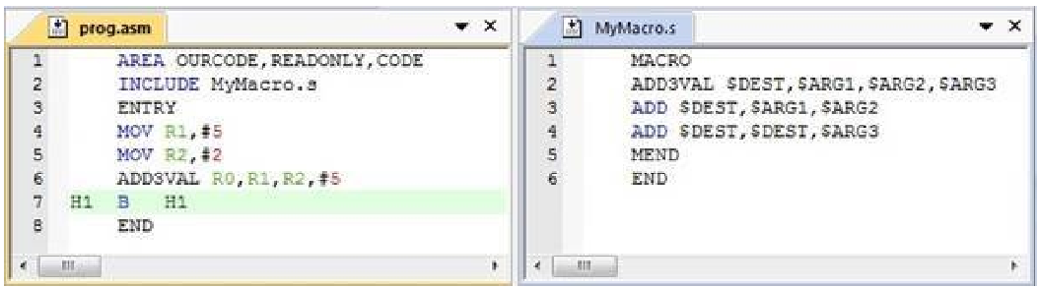
MACRO from Files
Include Directive
Microprocessors and Assembly Language, Spring 2020, AUT, Tehran, Iran

Slide 10
End of Appendix C!
Microprocessors and Assembly Language, Spring 2020, AUT, Tehran, Iran

